Slide 1
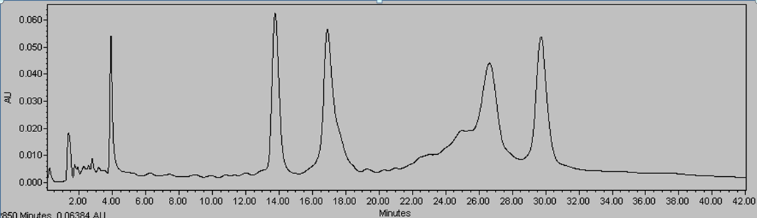
40 bases
60 bases
30 bases
50 bases
30 bases
Comp-60 | GGGTGAGATTCCAGCTTAACTTAGTTTTAGTTCCGCTTAGTACTTCTCAGGATCATCCGG
comp-50 | CCGGATGATCCTGAGAAGTACTAAGCGGAACTAAAACTAAGTTAAGCTGG
comp-40 | CCGGATGATCCTGAGAAGTACTAAGCGGAACTAAAACTAA
comp-30 | CCGGATGATCCTGAGAAGTACTAAGCGGAA

Slide 2
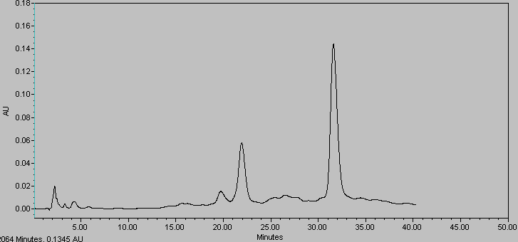
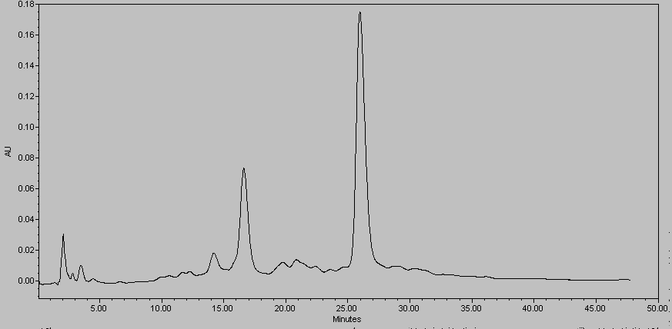
W1-long-Yazide | ATCAACGGCTGGCTGGTTTCTGCTCTCTAGTTTTT(azide)TTTGAGGTGCAATCTCCTATC

